Slide 1

Discovering the 5 Tastes
Brittany Lord & Becca Cochran

Slide 2
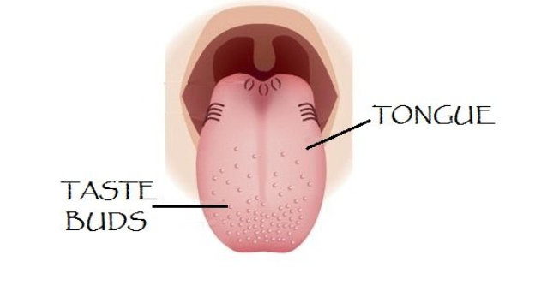
Why does food taste so good?
Notes:
Your taste buds are sensory organs that allow you to experience different flavors.
You can have anywhere from 2,000-10,000 taste buds on your tongue and even some on the roof of your mouth, your cheeks and throat.
(Older group)- The bumps shown on the tongue are called papillae. Your taste buds sit on top of these papillae, they contain tiny hairs called microvilli that send messages to the brain about how something tastes.

Slide 3

Did you know?
The number of taste buds you have and their location in your mouth are unique to you, just like your fingerprints!

Slide 4

Raise your hand if you can name
1 of the 5 taste sensations!

Slide 5
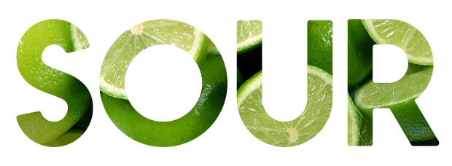


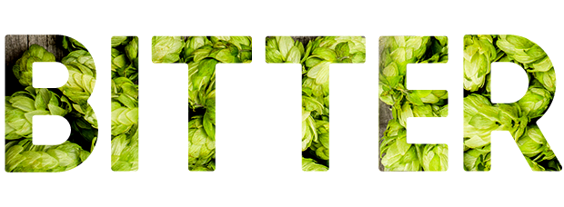

The 5 Taste Sensations

Slide 6



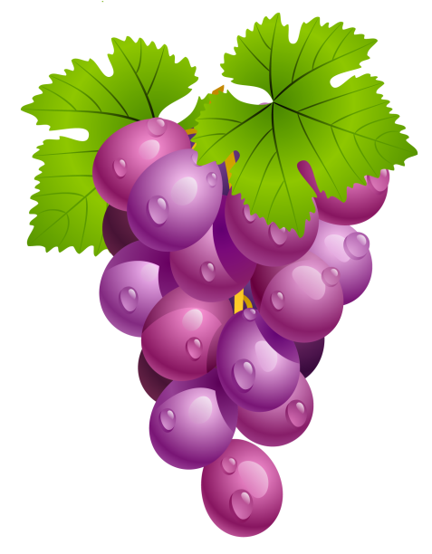
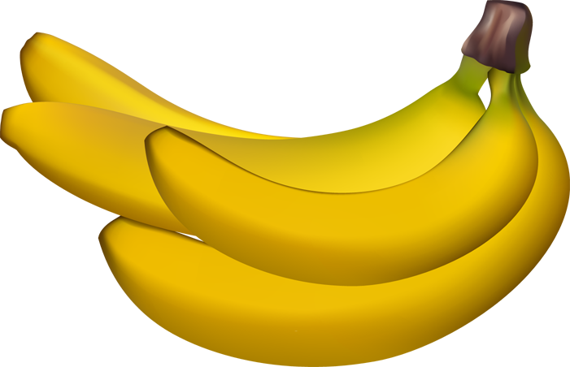
The “Sweet” Taste
Notes:
Sweetness is produced from the presence of sugars. Some foods that are sweet are fruits and desserts like ice cream and cake.
Did you know flavor comes from the combination of both the taste and smell of a food? Have you ever noticed how your food tastes bland when you have a stuffy nose?

Slide 7
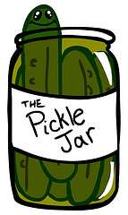
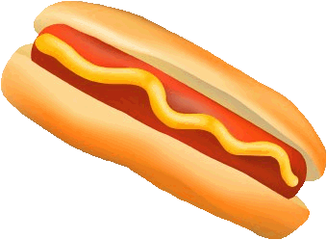
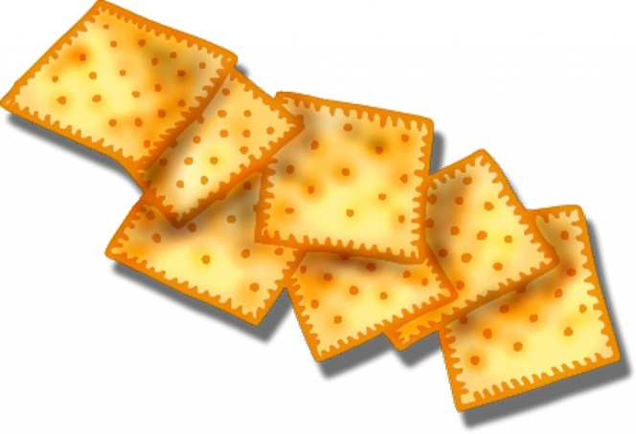
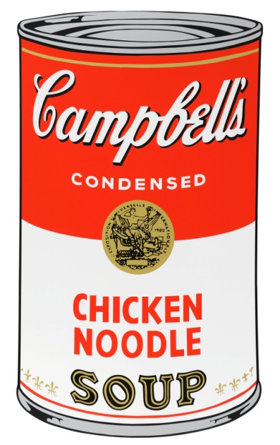
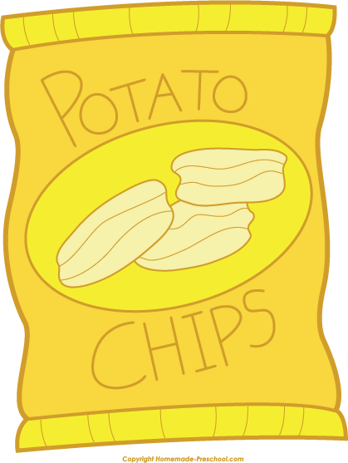
The “Salty” Taste
Notes:
Saltiness is produced from the presence of sodium in food.
Did you know taste receptors cannot actually taste food until your saliva has moistened it? This is because your saliva dissolves the food, allowing for your taste buds to detect the taste. For example, we usually taste salty things first because salt dissolves quickly in moisture. Some foods that are salty include chips, pickles, soups, crackers and deli meats.

Slide 8
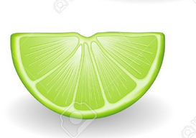
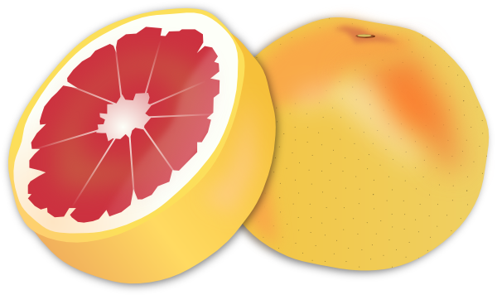
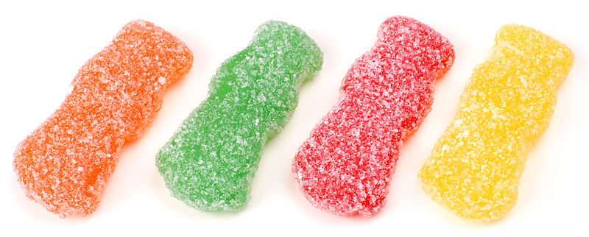
The “Sour” Taste
Notes:
Sourness is the taste that detects acidity. This taste may produce a strong response and make your lips pucker. Can you guys make a pucker face?
Some foods that are sour are limes and grapefruit.

Slide 9
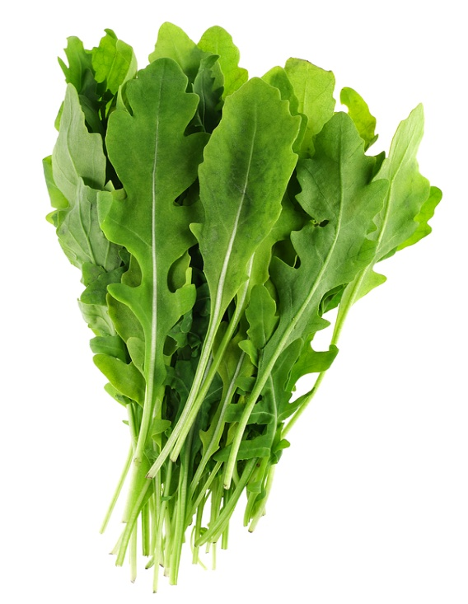
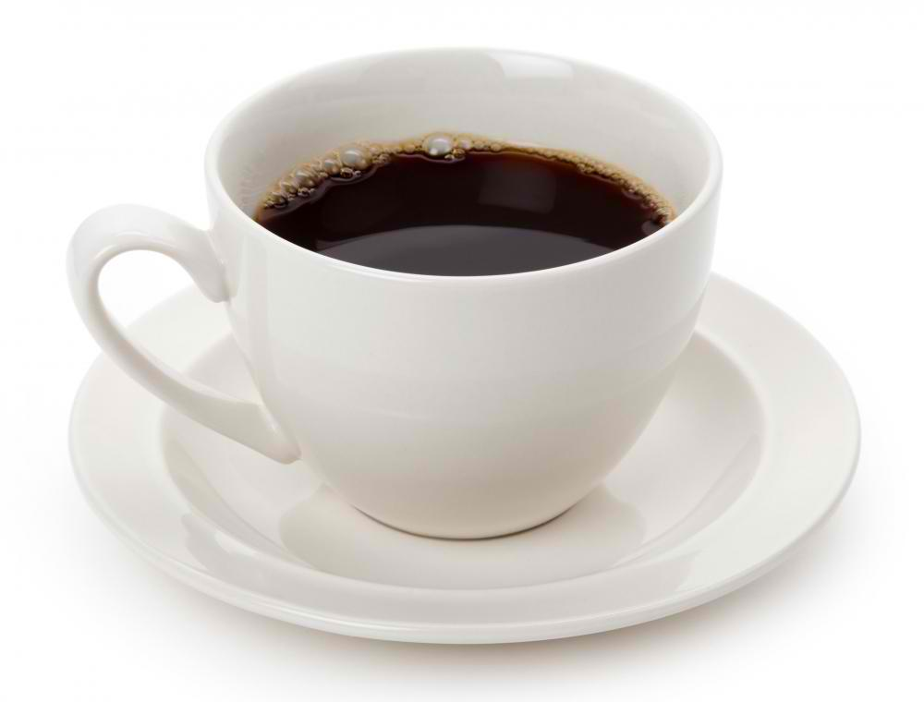
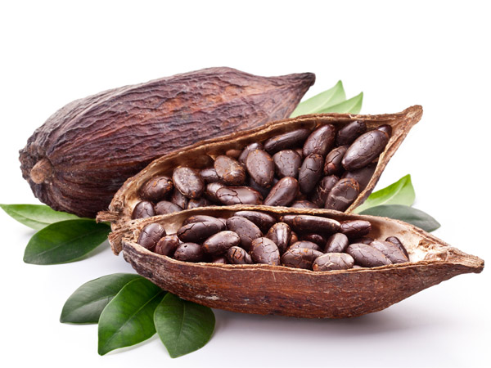
The “Bitter” Taste
Notes:
Bitterness is the most sensitive taste and can be produced by one of around 100 naturally-occurring compounds in food (Example: Tannins in coffee can make it taste bitter-and also brown your teeth).
You might perceive as unpleasant or sharp. Some foods that are bitter are coffee, arugula, and unsweetened cocoa.

Slide 10
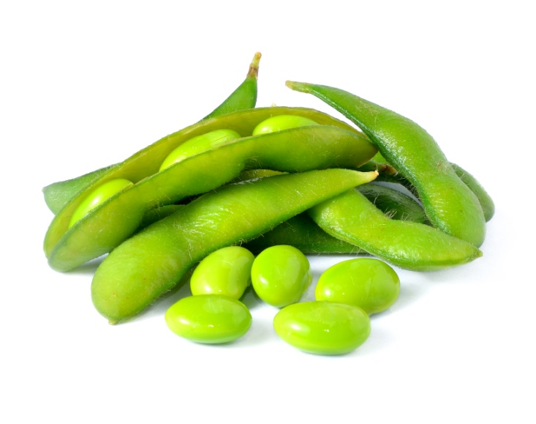
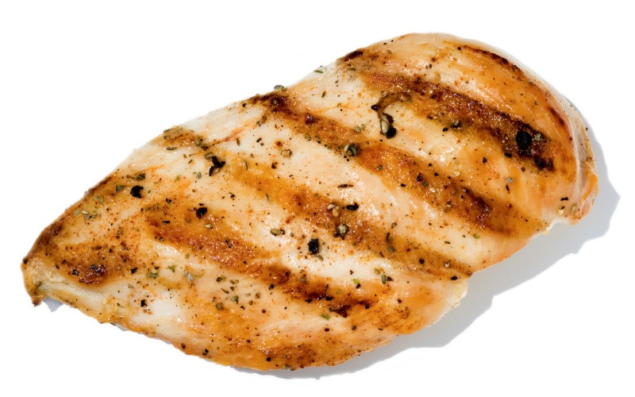
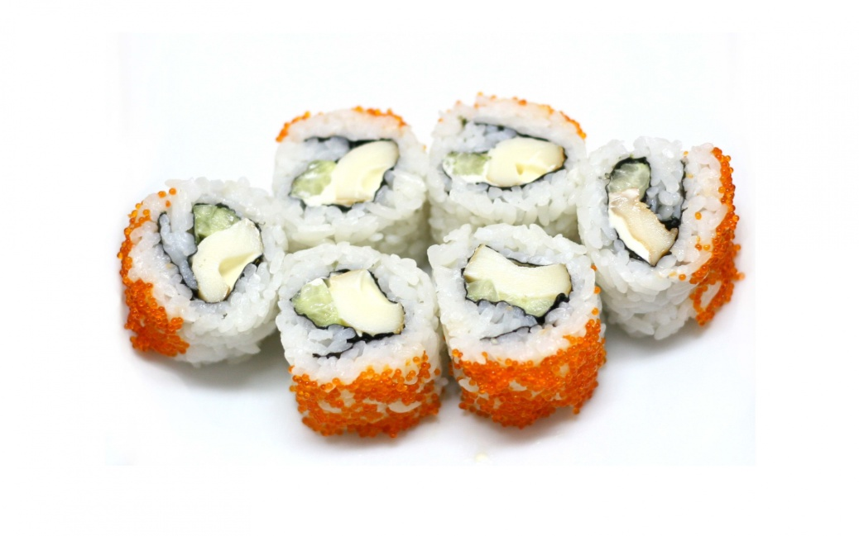
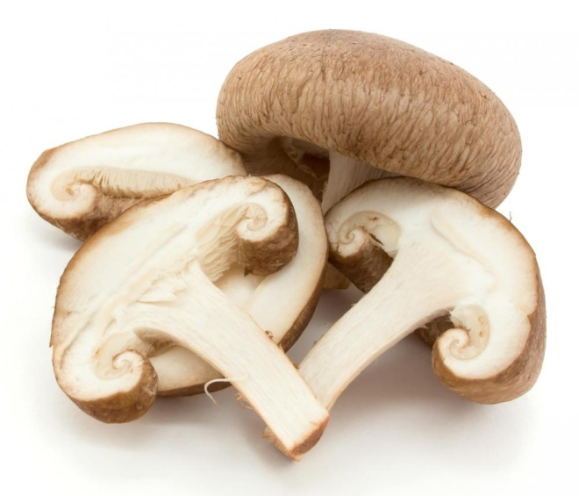
The “Umami” Taste
Notes:
The last taste is called Umami and is described as a savory or meaty taste. Some foods that are rich in Umami are mushrooms, meats, fish, and edamame.

Slide 11
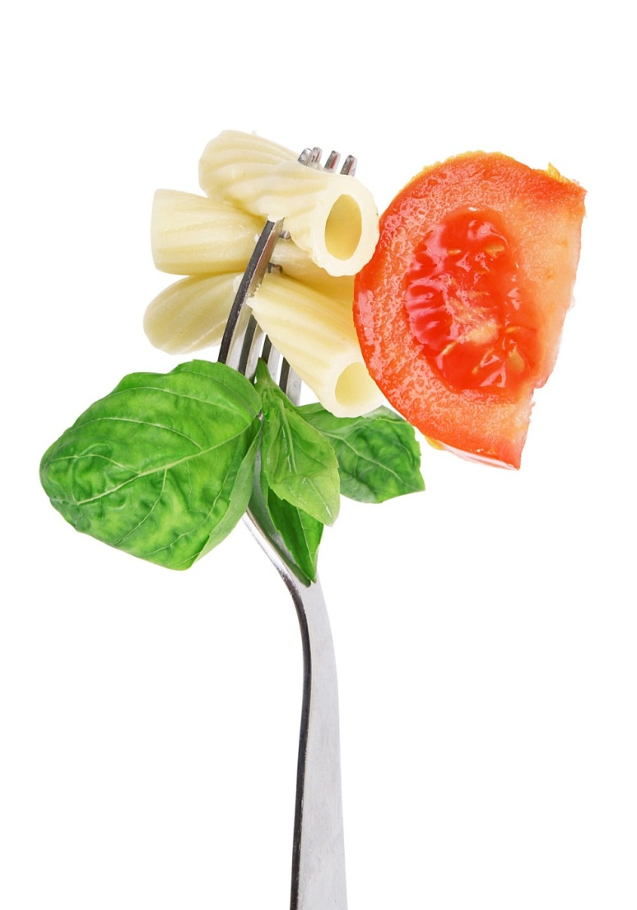
Let’s Taste!
Notes:
Presenter 1: Let’s start with the apple. Open up the bag and take a bite and think about what taste it has. What taste do you think it is? (Wait for a response). Yes! It is sweet tasting.
Presenter 2: Next take a bite of the pretzel. What taste do you think it is? (Wait for a response). Yes! It is salty tasting.
Presenter 1: Let’s take a bite of the lime. What taste do you think it is? (Wait for a response). Yes! It is very sour tasting.
Presenter 2: Next take a bite of the unsweetened chocolate chips. What taste do you think it is? (Wait for a response). Yes! It is bitter tasting.
Presenter 1: Lastly, let’s take a bite of the cheese. What taste do you think it is? (Wait for a response). Yes! It Umami, rich and savory tasting.

Slide 12

Which taste was your favorite?
Notes:
Now that everyone has sensed each of the five tastes, what is your favorite one?
Taste buds are always changing (average life span only 10-14 days) so your flavor preferences aren’t set in stone. Sometimes it takes more than 12 times trying a food to change your taste buds to like it! We encourage you to go home and keep trying new things!

