Slide 1
Food and Drug Administration’s (FDA)
New Nutrition Facts Label
Jamie Zeldman
University of Florida - Dietetic Intern
Notes:
Food and Drug Administration’s (FDA) - New Nutrition Facts Label Training – created/presented May 2020 by Jamie Zeldman, University of Florida - Dietetic Intern

Slide 2

Learning Objectives
By the end of this presentation, participants will be able to discuss the history of food labels.
By the end of this presentation, participants will be able to identify what is required on all food labels.
By the end of this presentation, participants will be able to identify the changes that will take place on the new Nutrition Facts Labels.
By the end of this presentation, participants will be able to recall which foods are exempt from the food label rule.
By the end of this presentation, participants will understand how to utilize the Nutrition Facts Label to support a healthy eating pattern.
Notes:
By the end of this presentation, participants will be able to discuss the history of food labels.
By the end of this presentation, participants will be able to identify what is required on all food labels.
By the end of this presentation, participants will be able to identify the changes that will take place on the new Nutrition Facts Labels.
By the end of this presentation, participants will be able to recall which foods are exempt from the food label rule.
By the end of this presentation, participants will understand how to utilize the Nutrition Facts Label to support a healthy eating pattern.

Slide 3
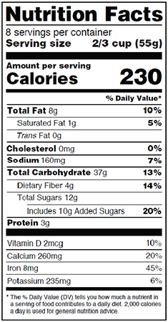
Do you regularly look at food labels when shopping?
What is the first thing you look at?
WHY?
Notes:
Maybe calories? Fat? Serving size?
What drew your eye to ____ first?

Slide 4

What is a food label?¹
Any written, printed or graphic matter on the food’s immediate container
Primary source of information about foods and products for consumers
Role of FDA:
  Responsible for assuring foods are safe, wholesome and properly labeled
  Authority to regulate food labeling as part of:
    1) Federal Food, Drug, and Cosmetic Act (FD&C Act)
    2) Fair Packaging and Labeling Act
Notes:
Definition is according to Title 21 of the Code of Federal Regulations
Provide much more than just nutrition facts: provide ingredients, which country food is produced from, whether it is organic or not, certain health claims (such as “light” or “low-fat”)

Slide 5
History of Food Labels²
1862
President Lincoln launches USDA
1906
Pure Food and Drugs Act
1913
Gould Amendment to Pure Food and Drugs Act
1938
Food, Drug & Cosmetic Act (FD&C)
1960
Food/Color Additives Amendment
1966
Fair Packaging and Labeling Act
1990
1993
1994
2003
2004
Nutrition Labeling and Education Act (NLEA)
Nutrition Facts Panel required under NLEA
Dietary Supplement Health & Education Act (DSHEA)
Labels must include trans fat
Food Allergen Labeling and Consumer Protection Act
2016
Final Rule on new Nutrition Facts Label
2020
FDA’s New Nutrition Label goes into effect
Notes:
1906: Pure Food and Drugs Act
Prohibited introduction of misbranded foods, drinks and drugs
Prohibited color additives to conceal inferiority/use of “poisonous” colors
1913: Gould Amendment
- Requires contents be marked on the outside of food package
1938: Food, Drug, and Cosmetic Act (FD&C)
- Serves as a basic framework for food regulation by the FDA and the USDA
Required that the label of every processed/packaged foods contain the name of the food, its net weight, and the name and address of the manufacturer or distributor
List of ingredients was required on certain products
Prohibited false or misleading statements in food labeling
1950s:
1957: Many standards set for varieties of different foods (flour, cereals, chocolate, bakery products, milk, cheese, juices, eggs)
1958: Food Additives Amendment – FDA published first list of GRAS substances (generally recognized as safe)
1960: Color Additive Amendment – establish safety of color additives
1966: Fair Packaging and Labeling Act
- Required products be honestly and informatively labeled, with FDA enforcing provisions on foods
1990: Nutrition Labeling and Education Act (NLEA) – nutrition label as we know it
Required uniform nutrition labeling
The labeling standards focused on the relationship between food contents and healthy diets
Provide adequate information to consumers regarding the content of food
Regulated/standardized nutrition content claims and health claims
1993: Nutrition Facts Panel
1994: Dietary Supplement Health and Education Act (DSHEA)
Established specific labeling requirements for dietary supplements
DSHEA defines "dietary supplements" and "dietary ingredients" and classifies them as food
2003: Trans fat on labels
Announced in 2003, but was not enacted until 2006
2004: Food Allergen Labeling and Consumer Protection Act
Requires protein source labeling of any food that is or contains an ingredient that is a major food allergen
Peanuts; soybeans; cow's milk; eggs; fish; crustacean shellfish, such as shrimp and crabs; tree nuts; and wheat
Took effect in 2006
2016: FDA proposed changes to the label in 2014 actually, and after 2 years, the FDA finalizes the new nutrition label set to launch in 2018
The 2 we are going to look at further are the Nutrition Labeling and Education Act (NLEA), because that really is the nutrition label as we know it today, when nutrition labeling became mandatory, and the final rules on the new Nutrition Facts label, since this is the first major change to the label since it was first introduced, 20 years later

Slide 6
Nutrition Labeling and Education Act of 1990 (NLEA)^{3,4}
Amended FD&C Act
Requires most foods to have nutrition labeling
Food labels must contain standardized nutrient content claims/health messages
Serving sizes should represent amount customarily consumed in a common household measurement
Notes:
Nutrition Labeling and Education Act, mandated that all food companies were required to make consistent claims and include a detailed, standardized nutrition facts panel on all products
Specified that serving sizes should represent “an amount customarily consumed and which is expressed in a common household measure that is appropriate to the food”
It also required standard definitions to be developed that characterized the level of nutrients and required FDA-approved health claims (such as “light” or “low-fat”)
Regulations regarding food labeling constantly changing: All new regulations are compiled annually in Title 21 of the Code of Federal Regulations (CFR)

Slide 7
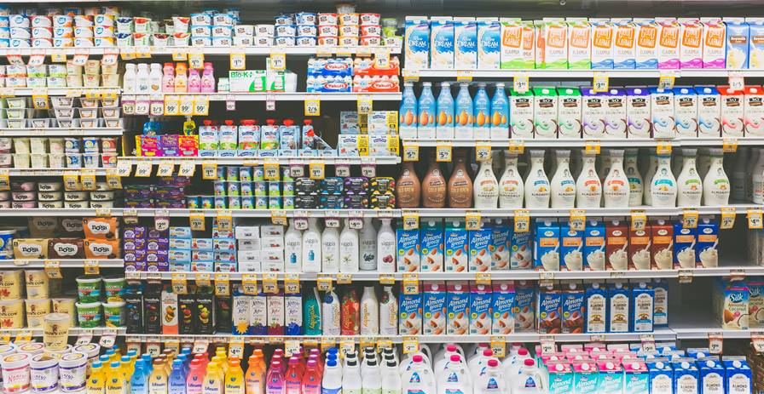
Which of the following do you think is required on food labels?
Food Allergens
Place of Manufacture
Health Claims
Nutrition Facts
All of the Above

Slide 8
Required Information on all Food Labels⁵
Principal Display Panel
Place of Business
Nutrient Label
Statement of Identity
Net Content Statement
Health Claims
Ingredients Statement
Notes:
Regulations regarding food labeling constantly changing: All new regulations are compiled annually in Title 21 of the Code of Federal Regulations (CFR)

Slide 9
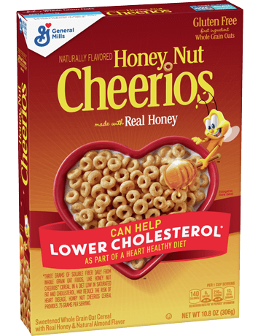
Example⁵
Principal Display Panel (PDP)
Statement of Identity
Net Content Statement
Health Claims
  NLEA, FDAMA, Qualified, Nutrient, Structure Function
Notes:
1. Principal Display Panel: portion of the label the consumer sees when the product sits on the shelf
- The Principal Display Panel is required to have 2 additional elements: a statement of identity and the net quantity of contents
2. Statement of identity: the common/usual name of the food item
- Honey Nut Cheerios
3. Net Content Statement: Can be expressed in terms of weight, measure, numerical count, or a combination
- Net Weight of 10.8 oz (306 g)
4. Health Claims: several types
Nutrition Labeling and Education Act Claims → calcium/vitamin D/osteoporosis, cholesterol and risk of coronary heart disease
Food and Drug Administration Modernization Act claims → exact language that must be used, accepted by FDA
Qualified Health Claims → must by accompanied by disclaimer or qualifying language to communicate the level of scientific evidence (supportive, but not conclusive research shows…)
Nutrient Content Claims → reduced, light, good source of, lean, fat free, etc.
Structure function → about the effect of a nutrient on the structure, function or general wellbeing → does not discuss specific diseases

Slide 10
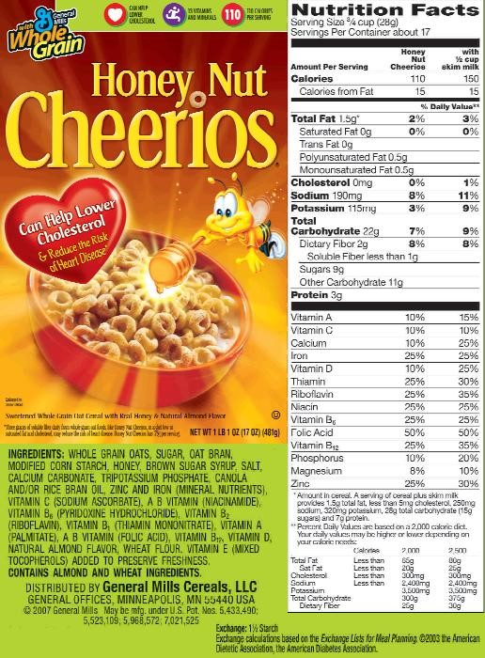
Example⁵
Name and Place of Business
Ingredient Statement
Nutrient Label*
Notes:
1. Name and Place of Business, Manufacturer, Distributor or Packer
General Mills
2. Ingredient Statement: should be listed by common or usual name in descending order by weight
Must mention potential allergens
“Contains almond and wheat ingredients”
3. Unless a product is exempt, all food products must contain a nutrition label
- Food labels have been required since 1990, but for the duration of the presentation we will be discussing the newest changes to the Nutrition Facts Label

Slide 11
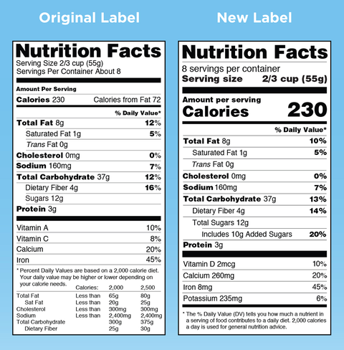
What’s the Difference?
Notes:
Ask participants to say out loud the differences they see:
Servings are larger and bolder font
Calories are larger font
Added sugars
Change in nutrients that are shown (no Vitamin A or C)
Actual nutrient amounts are shown (not just percent)
New footnote at bottom

Slide 12
Final Rule on New Nutrition Facts Label⁶
Based on updated research, the Dietary Guidelines for Americans, and input from the public
  Reflects link between diet and chronic diseases (i.e. obesity and heart disease)
Refreshed Design
  Easier for consumers to make more informed choices
Updated Serving Sizes
Notes:
2014: FDA proposed changes to the label
2016: FDA finalizes the new nutrition label set to launch in 2018
Launching the label:
Manufacturers with >$10 million in annual sales → new label by January 1, 2020
Manufacturers with <$10 million in annual sales → new label by January 1, 2021

Slide 13
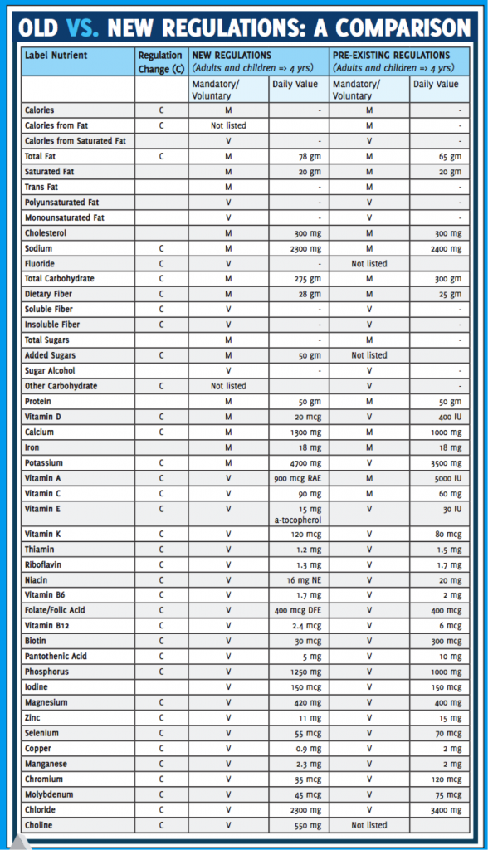
Reflects Updated Research⁶⁻⁸
Newly Required:
  “Added Sugars” in grams and as %DV
  Vitamin D and Potassium
  Updated Daily Values for Sodium, Dietary Fiber, Total Fat, Total Carbohydrate, Potassium, Calcium and Vitamin D
  Footnote on %DV
Still Required:
  Calcium and Iron
  Total Fat, Saturated Fat and Trans Fat
No Longer Required:
  Vitamins A and C
  “Calories from Fat”
Notes:
Newly Required:
Added Sugars → syrups, sugar, honey, etc.
Difficult to stay within daily recommended caloric range if >10% of diet is from added sugars
Esp. when if consuming highly processed diet
Diets lower in sugar-sweetened foods and beverages have been associated with lower risk of heart disease
Potassium and Vitamin D added → reflects that Americans do not consume sufficient amounts on a regular basis
DV Changes → DV of any vitamin or mineral listed can not exceed 100%
Updated DV based on newer evidence from the Institute of Medicine and to reflect the same recommendations as the DGA 2015-2020
Sodium → 2400 mg to 2300 mg
Fiber → 25 g to 28 g
Total Fat → 65 to 78 g
Carbohydrate → 300 to 275 g
Potassium → 3500 to 4700 mg
Calcium → 1000 to 1300 mg
Vitamin D → 10 to 20 mcg
Footnote → “The %DV tells you how much a nutrient in a serving of food contributes to daily diet. 2000 kcal/day is used for general nutrition advice”
Explain to consumer what %DV means in context of daily diet
No Longer Required:
Vitamins A and C → deficiency is rare, removed due to lack of relevance
Just because Vitamins A and C are no longer required, they can still be included voluntarily
Calories from Fat → evidence shows that the type of fat is more important than the amount of fat (MUFA/PUFA may be considered healthy)

Slide 14
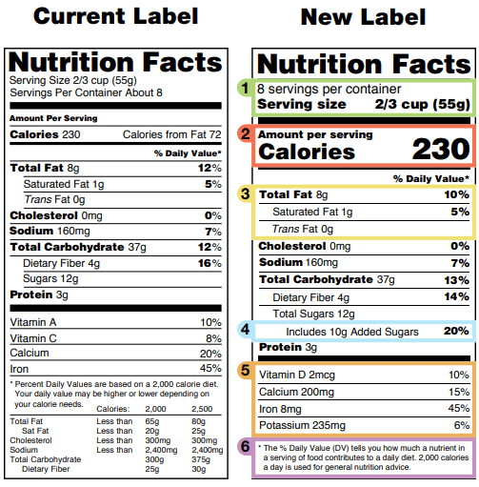
Refreshed Design^{6,8}
Traditional “look” remains the same
Larger font for “Calories”, “Servings Per Container”, and “Serving Size”
Bold font for calories and serving size
Must provide actual amount and %DV for Vitamin D, Calcium, Iron and Potassium
Revised Footnote
Notes:
Font for calories was significantly increased and bolded for consumers to simply understand without having to look very deeply into the food label
Revised footnote better explains what %DV means

Slide 15
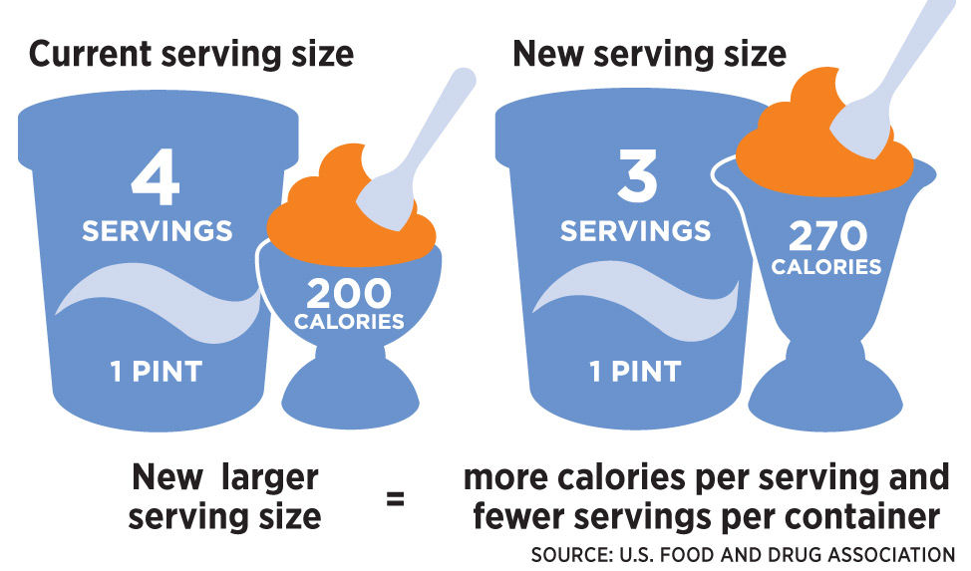
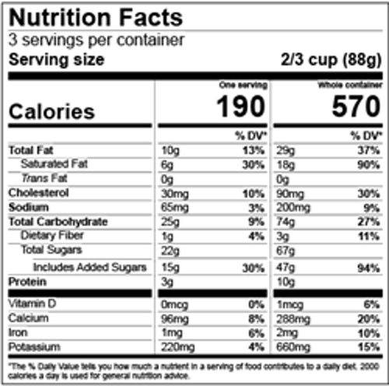
Updated Serving Sizes⁶
Based on amounts that consumers actually eat
  Not what they should be eating
  Ex: Ice cream – 1/2 cup → 2/3 cup
Packages between 1 and 2 servings → labeled as 1 serving
  Package size affects what people eat
  Ex: 20 oz soda → 1 serving
“Dual Column” Labels
  Could be consumed in one or multiple sitting
  “Per Serving” vs. “Per Package/Unit”
Notes:
How much people eat has changed since 1990, when the previous requirements were published
More realistic serving sizes
2- oz soda considered 1 serving, because it is most likely going to be consumed in one sitting
Dual Column Labels: Examples would be a 24-ounce bottle of soda or a pint of ice cream
- Consumers can more easily understand how many calories and nutrients they are getting if they eat or drink the entire package/unit at one time

Slide 16
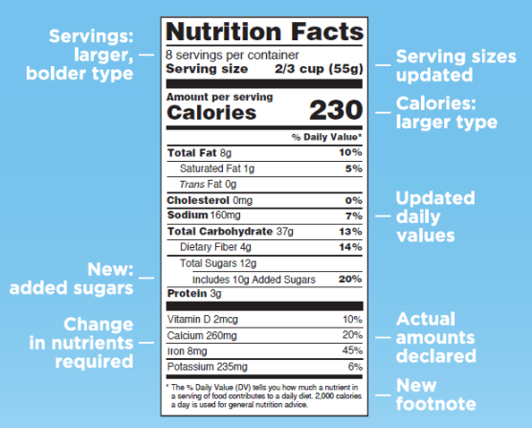
Summary⁶
Notes:
Added sugars, vitamin D, and potassium are now listed

Slide 17
Are all foods required to have a nutrition label?
Notes:
Check Your Knowledge:
Question:
Are all foods required to have a nutrition label?
Answer:
No

Slide 18
Foods Exempt From Final Rule⁹
Offered by retailer who has annual sales <$500,000
Served in restaurants
Served for immediate consumption (schools, hospitals, airplanes, etc.)
Ready-to-eat, not for immediate consumption, prepared on site (bakery, deli, etc.)
Shipped in bulk, not for sale in that form to customers
Medical foods
Insignificant amounts of all nutrients (coffee beans, tea leaves, spices, etc.)
Notes:
Medical foods - intended to meet distinctive nutritional requirements of a disease or condition, used under medical supervision, and intended for the specific dietary management of a disease or condition.
- Example: Axona for Alzheimer’s Disease

Slide 19
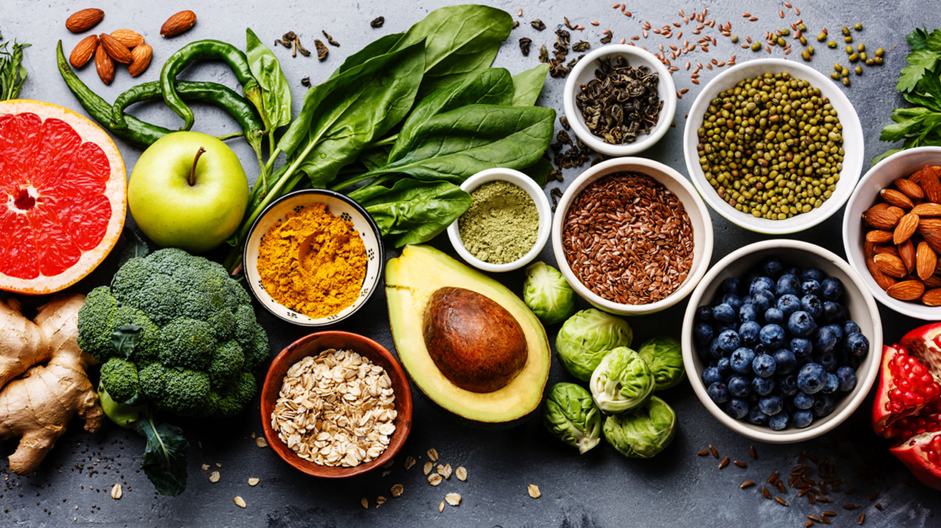
Key Elements of Healthy Eating Patterns¹⁰
Includes:
  Variety of vegetables from all subgroups (dark green, red/orange, legumes, starchy, other)
  Fruits (esp. whole)
  Grains (at least half whole)
  Fat-free or low-fat dairy
  Variety of protein foods
  Oils
Limits:
  Saturated fats, trans fats, added sugars, sodium
  <10% of calories/day from saturated fats
  <10% of calories/day from added sugars
  <2300 mg/day sodium
Notes:
Key Recommendations from the 2015-2020 Dietary Guidelines for Americans
Consume a healthy eating pattern that accounts for all foods and beverages within an appropriate calorie level
Mindful about serving sizes → How many servings in 1 package?
Number of servings consumed determines number of calories consumed
5%DV – considered low; 20%DV – considered high

Slide 20
Using the Nutrition Facts Label^{6,11}
1. Start with serving size
2. Check out Total Calories
3. Let % DV be a Guide
4. Acknowledge Health Claims
5. Choose Low in Saturated Fat, Added Sugars and Sodium
6. Aim for High Fiber, Potassium, Vitamin D, Calcium and Iron
7. Consider Additional Nutrients
Notes:
1. Be mindful about serving sizes → How many servings in 1 package?
Number of servings consumed determines number of calories consumed
3. % DV → to evaluate how food fits into your daily meal plan
<5% = considered low
>20% = considered high
4. Low calorie, low cholesterol, good source of, reduced, fat free, high in, etc.
5. Less sat fat, added sugar and sodium may help reduce risk for chronic disease
Sat fat and trans fat linked to increased risk of heart disease
High sodium can lead to high blood pressure
6. Aim for high %DV of these nutrients
7. Consider protein, carbohydrates and sugars

Slide 21
Use the Nutrition Facts Label to support personal dietary needs
Choose foods with more of the nutrients you want more of and less of the nutrients you may want to limit!⁶
Notes:
Support personal dietary needs:
Choose foods with more of the nutrients you want more of and less of the nutrients you may want to limit!

Slide 22
References
CFR - Code of Federal Regulations Title 21. accessdata.fda.gov. https://www.accessdata.fda.gov/scripts/cdrh/cfdocs/cfcfr/CFRSearch.cfm?fr=1.3.
Commissioner Oof the. A Century of Ensuring Safe Foods & Cosmetics. U.S. Food and Drug Administration. https://www.fda.gov/about-fda/histories-product-regulation/century-ensuring-safe-foods-cosmetics.
Center for Food Safety and Applied Nutrition. Guidance For Industry Food Labeling Guide. U.S. Food and Drug Administration. https://www.fda.gov/regulatory-information/search-fda-guidance-documents/guidance-industry-food-labeling-guide.
Institute of Medicine (US) Committee on Examination of Front-of-Package Nutrition Rating Systems and Symbols; Wartella EA, Lichtenstein AH, Boon CS, editors. Front-of-Package Nutrition Rating Systems and Symbols: Phase I Report. Washington (DC): National Academies Press (US); 2010. 2, History of Nutrition Labeling. Available from: https://www.ncbi.nlm.nih.gov/books/NBK209859/
Labeling Course Summary. U.S. Food and Drug Administration. https://www.accessdata.fda.gov/ORAU/Labeling/LAB_summary.htm.
Center for Food Safety and Applied Nutrition. Changes to the Nutrition Facts Label. U.S. Food and Drug Administration. https://www.fda.gov/food/food-labeling-nutrition/changes-nutrition-facts-label.
Food Labeling: Revision of the Nutrition and Supplement Facts Labels. Regulations.gov. https://www.regulations.gov/document?D=FDA-2012-N-1210-0875.
2020 FDA Regulations for Food Labeling: Are You Compliant? LabelCalc. https://labelcalc.com/fda-regulations/2020-fda-regulations-for-food-labeling-are-you-compliant/. Published February 4, 2020.
Waxman, A. H. H.R.3562 - 101st Congress (1989-1990): Nutrition Labeling and Education Act of 1990. Congress.gov. https://www.congress.gov/bill/101st-congress/house-bill/3562. Published November 8, 1990.
Chapter 1 Key Elements of Healthy Eating Patterns. Key Recommendations: Components of Healthy Eating Patterns - 2015-2020 Dietary Guidelines. https://health.gov/our-work/food-nutrition/2015-2020-dietary-guidelines/guidelines/chapter-1/key-recommendations/.
Ellis E. The Basics of the Nutrition Facts Label. EatRight. https://www.eatright.org/food/nutrition/nutrition-facts-and-food-labels/the-basics-of-the-nutrition-facts-label.

Slide 23
Thank You
For more information, visit FDA’s website: https://www.fda.gov/food/food-labeling-nutrition

