Slide 1
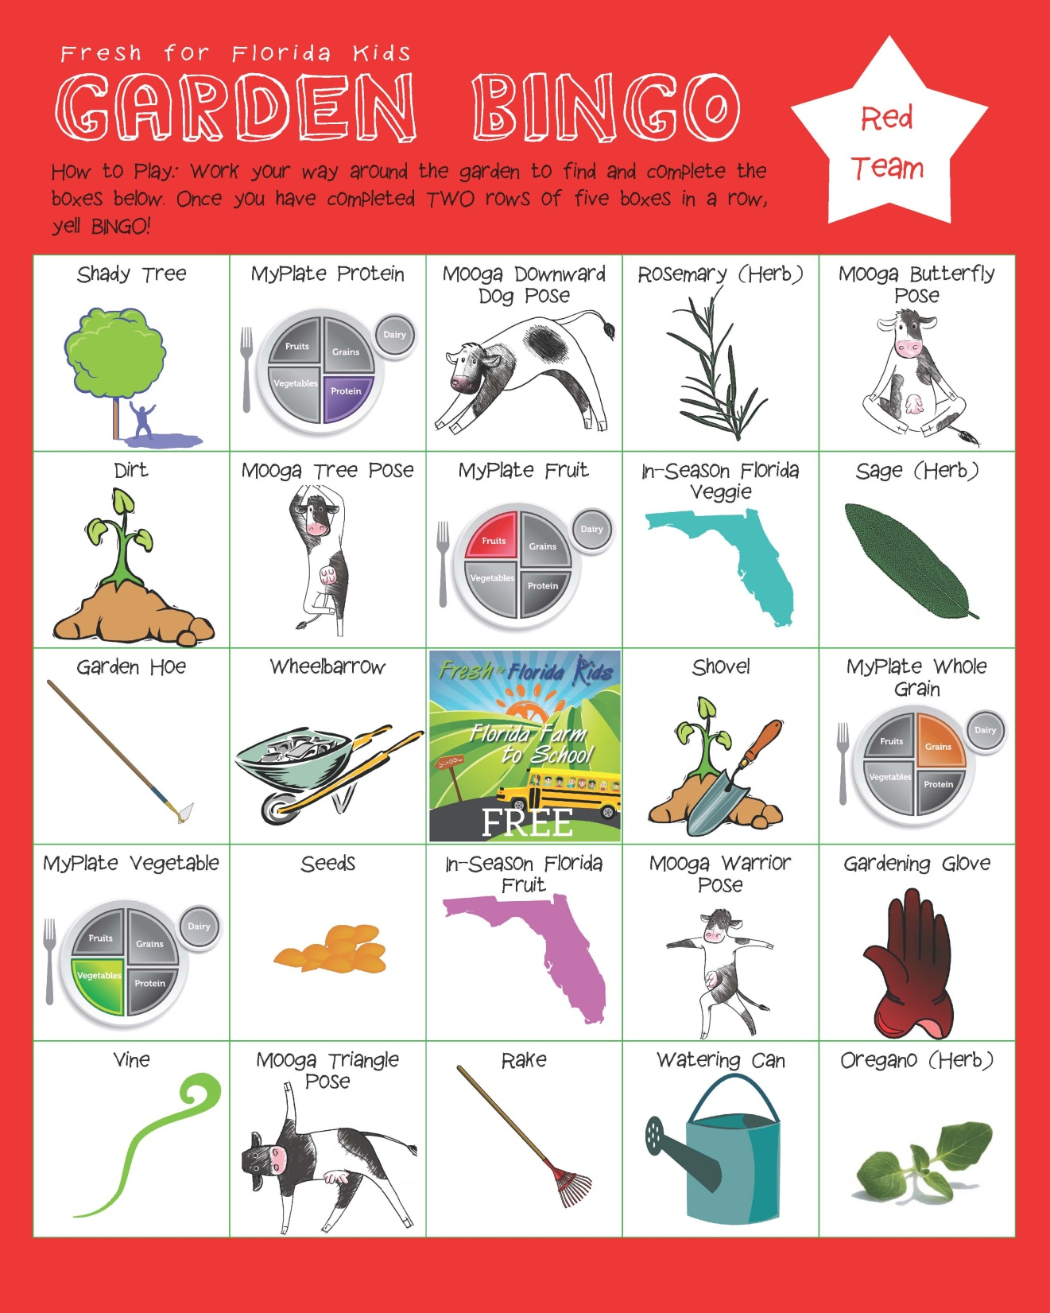
Did you know that the oldest shovel ever found was 4,000 years old?
High-5 everyone in the group.

Slide 2

How do you like to eat your whole grains?

Slide 3
Name four (4) green vegetables.

Slide 4
Did you know that tomatoes are considered fruits because they have seeds? Any produce with seeds is a fruit.

Slide 5
Did you know that strawberries are the only fruit with seeds on the outside?
What are your favorite fruits?

Slide 6
What are two reasons we should wear gloves while gardening?

Slide 7
Name a fruit that grows on a vine.

Slide 8
Say
“Jake’s rake baked a cake” five (5) times fast.

Slide 9
Watering cans are a form of “irrigation”—What are some other forms of irrigation?

Slide 10
Make sure to crush dry oregano to release the essential oils and flavors

Slide 11

Tree Simon Says

Slide 12
Protein is used by the body to build muscle, skin, bone and more. Name two protein sources.

Slide 13
Rosemary can grow to five (5) feet tall.
Hop on your left foot ten (10) times.

Slide 14
Other than dirt, what other things do plants need to grow?

Slide 15
Name a red, yellow, and blue fruit.

Slide 16
Name your favorite vegetable.

Slide 17
Juice from sage leaves can help soothe insect bites

Slide 18
This tool helps keep weeds away in a garden.
Why would a farmer want to keep weeds out of their garden?

Slide 19
What things could you carry in a wheelbarrow while gardening?

