Slide 1
Offer Versus Serve (OVS)
Grades K-8

Slide 2
Age-Grade Group K-8
Offer versus Serve (OVS) is optional for lower grades (grades K-8)
Five full components must be offered:
  Meat/Meat Alternate minimum 1 oz equivalent
  Grain minimum 1 oz equivalent
  Vegetable 3/4 cup
  Fruit 1/2 cup
  Fluid Milk 1 cup
Note: Most menu plans will need to be prepared with 2 oz of meat/meat alternate and 2 oz equivalents of grains per day to fall within the minimum and maximum weekly ranges.

Slide 3
Age-Grade Group K-8
OVS
A Reimbursable Meal must contain three of five components.
Two full components
and
A Fruit or Vegetable component or a combination of the two to make the third.
  At least 1/2 cup

Slide 4
Age-Grade Group K-8
OVS
Decline options:
  Students are allowed to decline any two of five food components but must select at least 1/2 cup of either a Fruit or Vegetable or smaller portions combined equaling 1/2 cup.

Slide 5
Age-Grade Group K-8
OVS
Minimum amount of Fruit and Vegetable:
  The minimum creditable serving size for a fruit or a vegetable is 1/8 cup.
  Students must select at least 1/2 cup of Fruit or Vegetable for a reimbursable meal under OVS.

Slide 6
Age-Grade Group K-8
OVS Activity
Review the following tray containing all five full components.

Slide 7
K-8 Grade Grouping
Grain
1 oz minimum offered
Fruit
1/2 cup offered
Milk
1 cup offered
1 oz minimum offered
Meat/Meat Alternate
Vegetable
3/4 cup offered
Most daily menu plans should offer 2 oz of M/MA & 2 oz equivalents of Grains per day.
Notes:
All

Slide 8
Age-Grade Group K-8
OVS
Yes……… or……….. No?
Look at the following trays and determine if the meals are reimbursable under OVS.
Explain your answer.

Slide 9
K-8 Grade Grouping Example 1
Milk
1 cup
1 oz
Meat/Meat Alternate
Vegetable
1/2 cup
Notes:
All

Slide 10
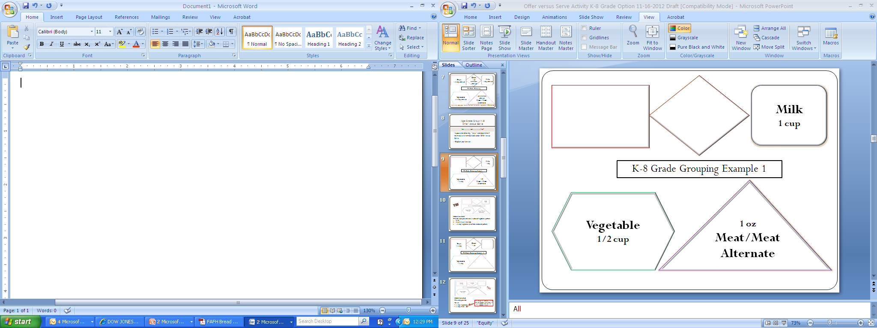
Yes
Student selected:
Two full components and a reduced vegetable portion:
Milk
Meat/Meat Alternate
1/2 cup Fruit (allowable reduced portion)

Slide 11
K-8 Grade Grouping Example 2
Grain
1 oz
Fruit
1/4 cup
Vegetable
1/4 cup
Notes:
All

Slide 12
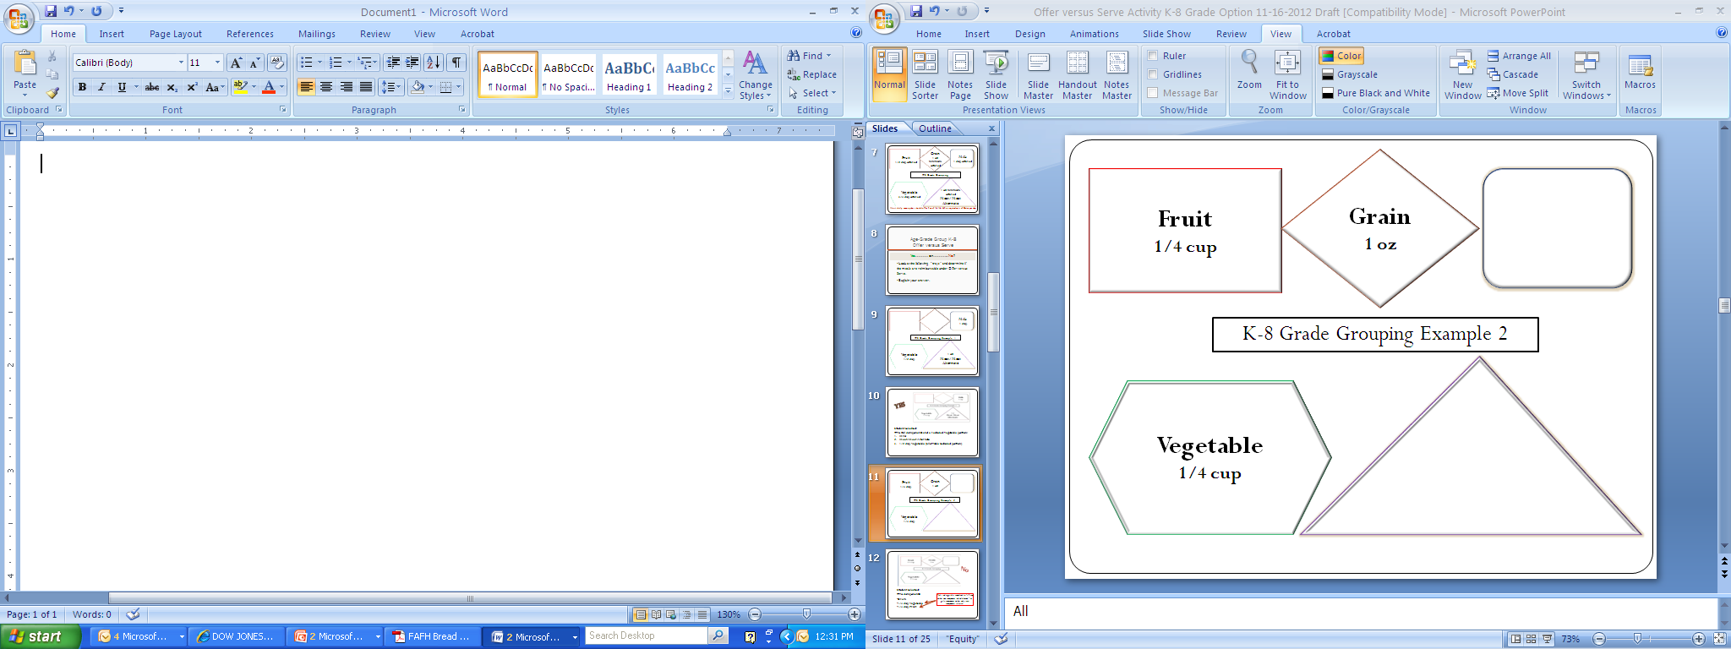
No
Student selected:
Two components from three items:
Full Grain
1/2 cup Vegetable
1/2 cup Fruit
Fruit and vegetables combined to 1/2 cup makes one component and minimum 1 oz grain component makes only two components selected.

Slide 13
K-8 Grade Grouping Example 3
Grain
2 oz
Fruit
1/2 cup
Vegetable
1/8 cup
Notes:
All

Slide 14
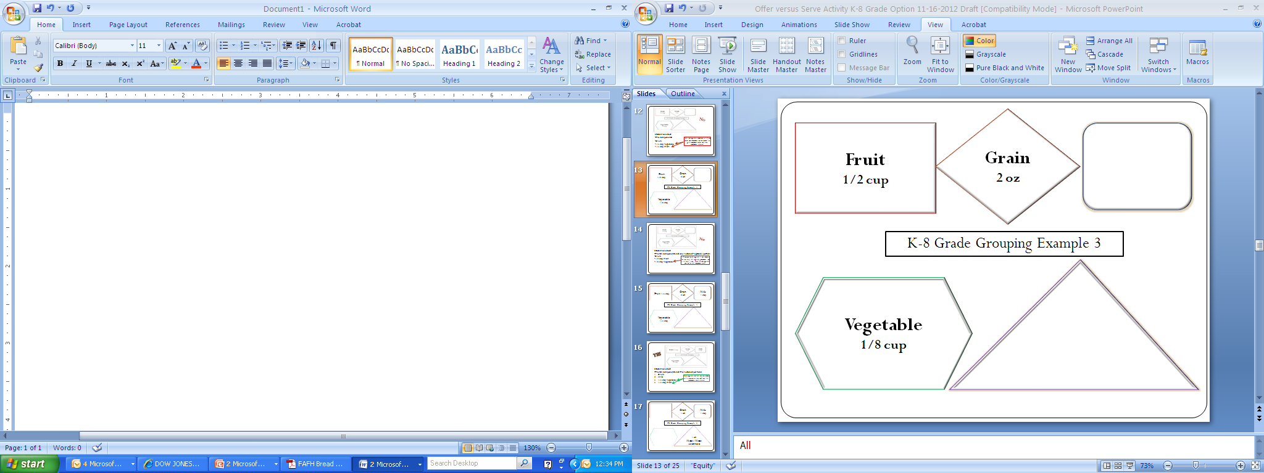
No
Student selected:
Two full components and one reduced vegetable portion:
Grain
1/2 cup Fruit
1/8 cup Vegetable
1/8 cup portion of vegetable is not adequate for the third full vegetable component and is an extra item. Need 1/2 cup vegetable or more for full component credit.

Slide 15
K-8 Grade Grouping Example 4
Grain
2 oz
Fruit
1/4 cup
Milk
1 cup
Vegetable
1/4 cup

Slide 16
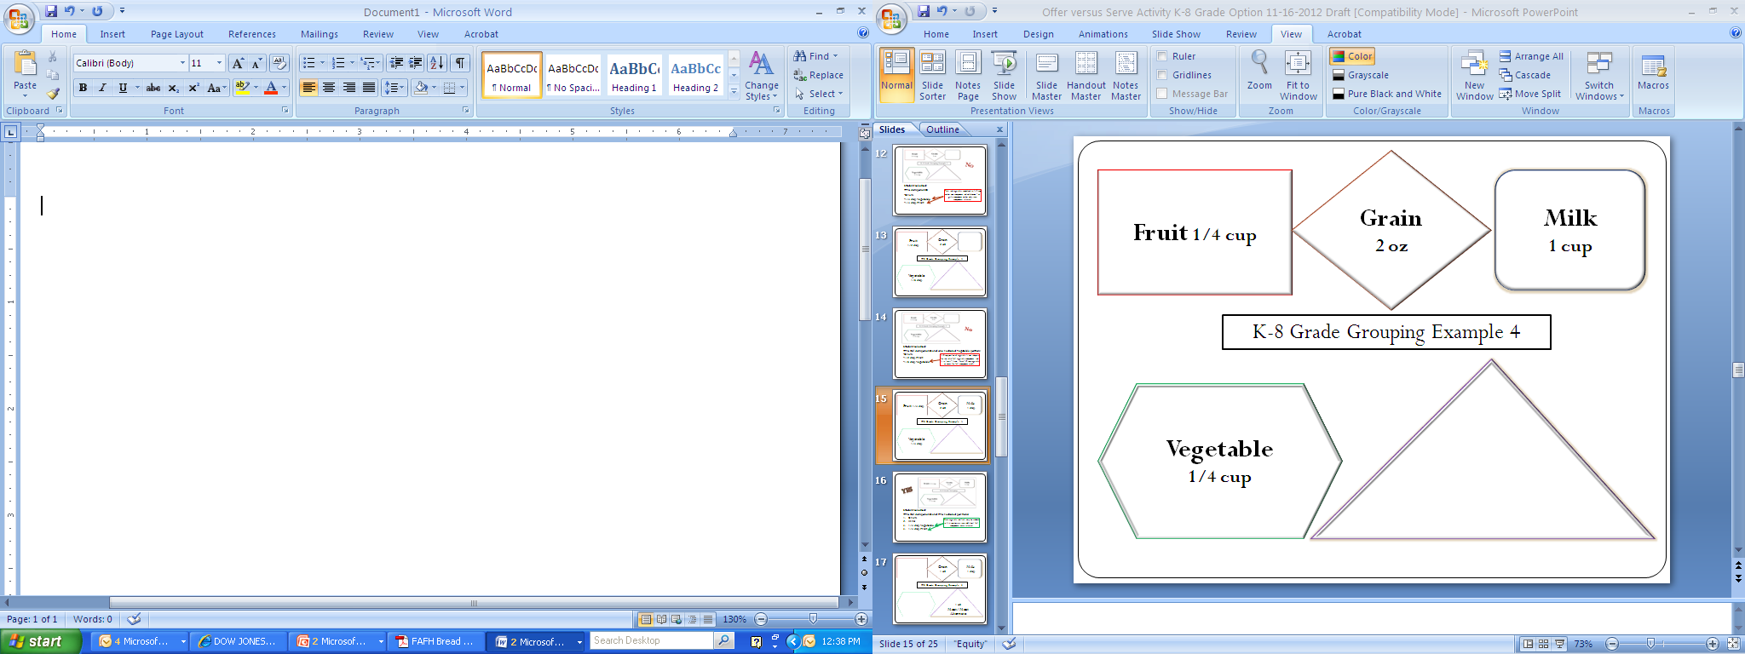
Yes
Student selected:
Two full components and two reduced portions:
Grain
Milk
1/4 cup Vegetable +
3. 1/4 cup Fruit
Both vegetable and fruit may be reduced to 1/4 cup because two additional full components were selected.

Slide 17
K-8 Grade Grouping Example 5
Grain
2 oz
Milk
1 cup
2 oz
Meat/Meat Alternate

Slide 18
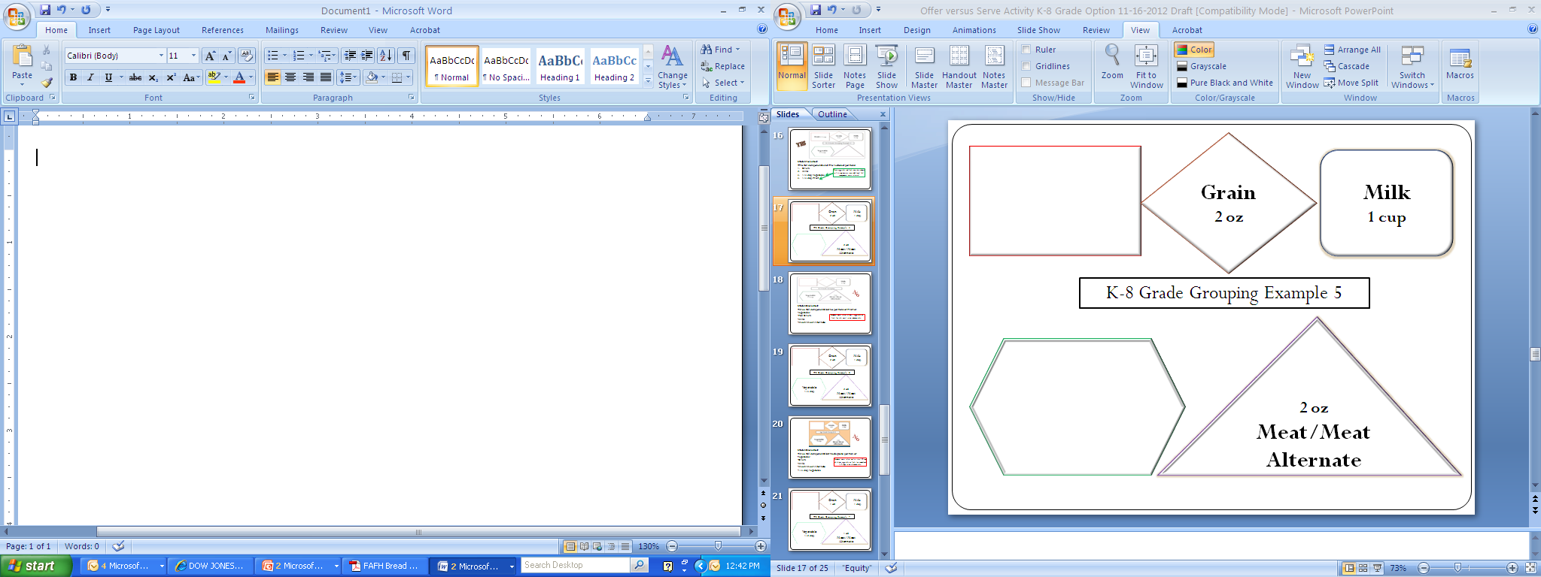
Students must select either a ½ cup of fruit or ½ cup of vegetable (or combination equaling ½ cup or more) for this meal to be reimbursable.
Tip: Offer multiple choices of Fruit choices daily at each meal from fresh, frozen, canned, dried and 100% juices.
No
Student selected:
Three full components but did not select a portion of a fruit or vegetable:
Full 2 oz. eq. Grain
Milk
Meat/Meat Alternate

Slide 19
K-8 Grade Grouping Example 6
Grain
2 oz
Milk
1 cup
2 oz
Meat/Meat Alternate
Vegetable
1/4 cup

Slide 20
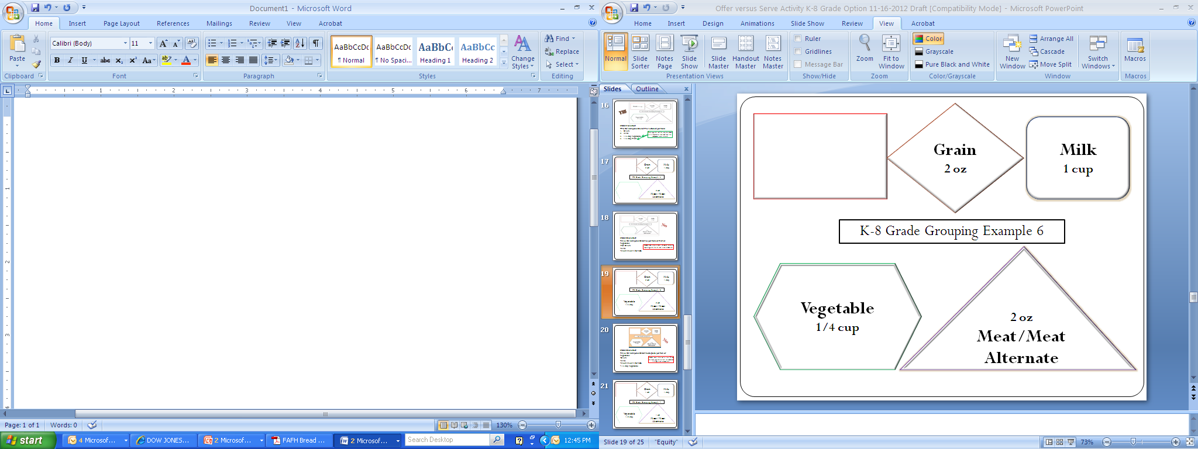
No
Student selected:
Three full components but inadequate portion of vegetable:
Grain
Milk
Meat/Meat Alternate
1/4 cup Vegetable
Students must select no less than 1/2 cup of fruit, vegetable or combined 1/2 cup to be reimbursable.

Slide 21
K-8 Grade Grouping Example 7
Grain
1 oz
Milk
1 cup
2 oz
Meat/Meat Alternate
Vegetable
1/2 cup

Slide 22
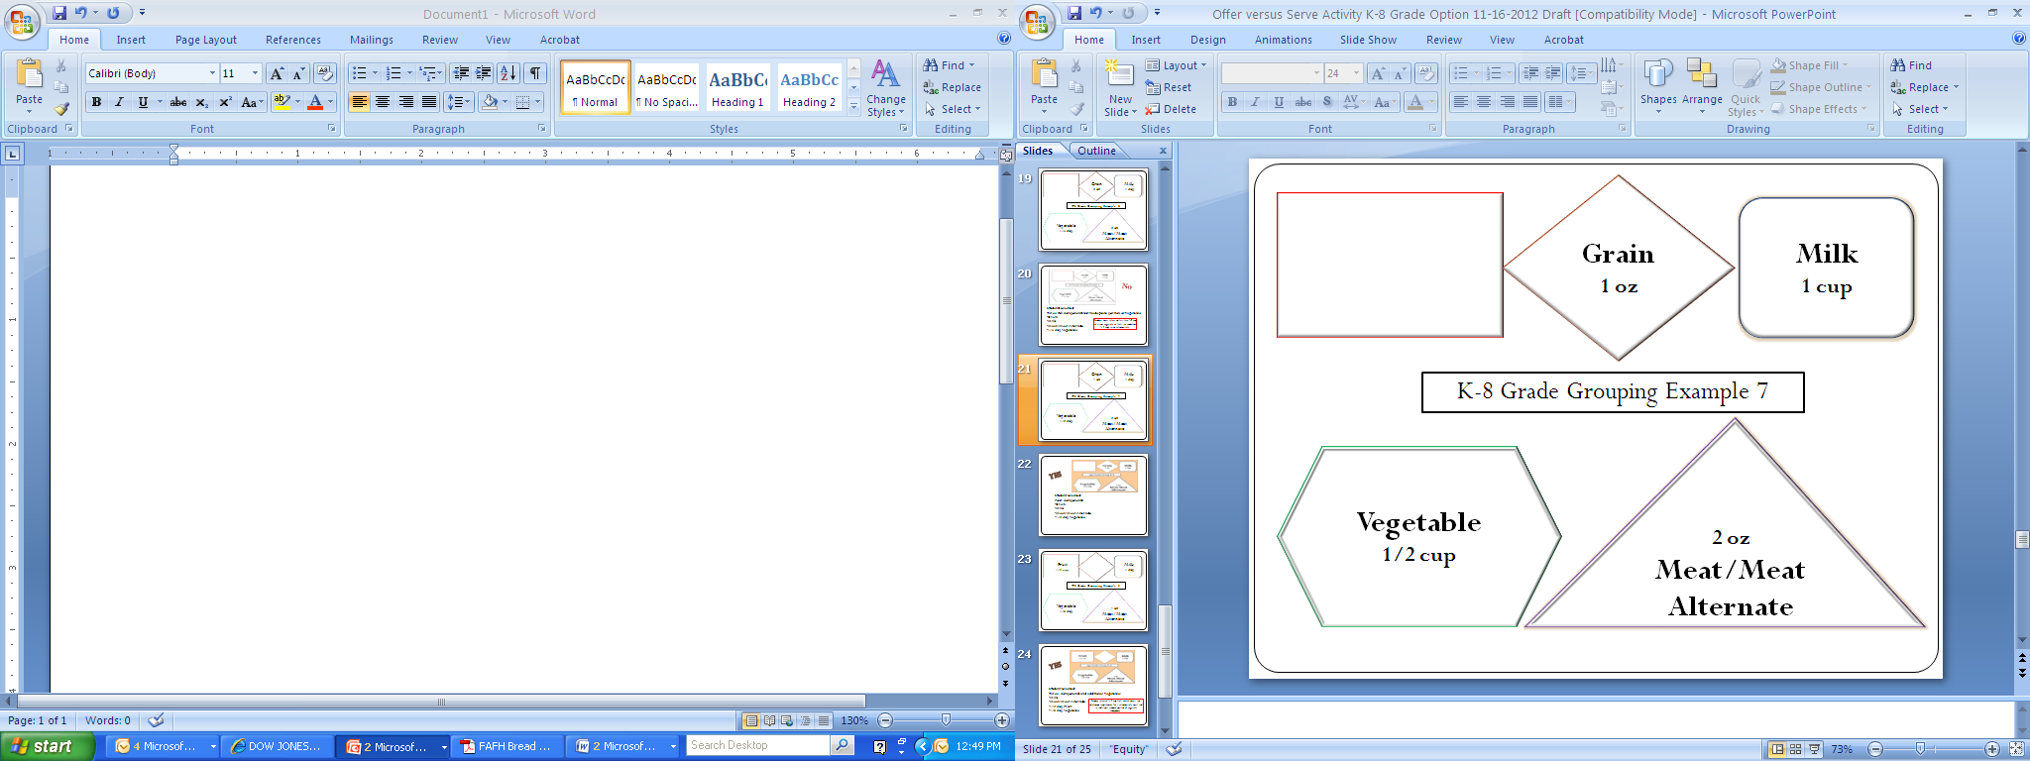
Yes
Student selected:
Four components:
Grain
Milk
1/2 cup Vegetable
Meat/Meat Alternate

Slide 23
K-8 Grade Grouping Example 8
Fruit
1/2 cup
Milk
1 cup
1 oz
Meat/Meat Alternate
Vegetable
1/8 cup

Slide 24
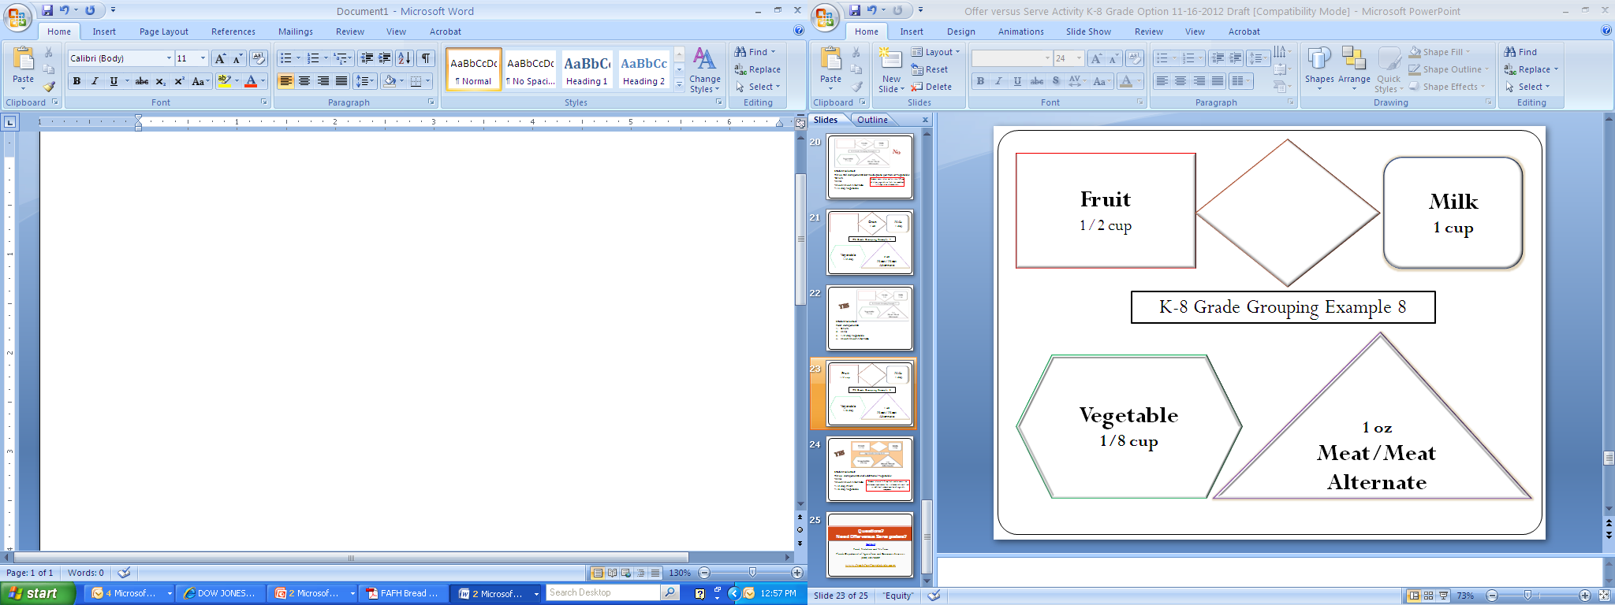
Yes
Student selected:
Three full components and extra vegetable:
Milk
Meat/Meat Alternate
1/2 cup Fruit
1/8 cup Vegetable
Student selected 1/2 cup fruit which meets the minimum requirement for a reimbursable meal and an extra reduced portion of vegetable component.

Slide 25
OVS – Summary/Comparison Chart
OVS is optional for grades K-8 in lunch and breakfast. | OVS is required for high school grades 9-12 at lunch and optional at breakfast.
Five full components must be offered: Meat/Meat Alternative minimum 1 oz. Grain minimum 1 oz. Vegetable 3/4 cup Fruit 1/2 cup Fluid Milk 1 cup | Five full components must be offered: Meat/Meat Alternative minimum 2 oz. Grain minimum 2 oz. Vegetable 1 cup Fruit 1 cup Fluid Milk 1 cup
A reimbursable meal must contain three of five components A fruit or vegetable component (or combination of the two) with at least 1/2 cup portion and Two other full components
Decline options: Students are allowed to decline any two of five food components but must select at least 1/2 cup of either a fruit or vegetable or smaller portions combined equaling 1/2 cup.
Minimum amount of fruit and vegetable: The minimum creditable serving size for a fruit or a vegetable is 1/8 cup. Dried fruit doubles in credit (1/4 cup is 1/2 cup of fruit). Fresh, raw salad greens are halved (1 cup of romaine is 1/2 cup of vegetable).

Slide 26
Questions?
Need OVS posters?
Contact
Food, Nutrition and Wellness
Florida Department of Agriculture and Consumer Services
(850) 617-7400
National School Lunch Program / Nutrition Programs / Food & Nutrition / Home - Florida Department of Agriculture & Consumer Services (fdacs.gov)

