Slide 1
Offer Versus Serve (OVS)
9-12 Grade

Slide 2
Age-Grade Group 9-12
Offer Versus Serve (OVS) is required for High School (grades 9-12)
Five full components must be offered:
  Meat/Meat Alternate minimum 2 oz equivalent (eq.)
  Grain minimum 2 oz eq.
  Vegetable 1 cup
  Fruit 1 cup
  Fluid Milk 1 cup

Slide 3
Age-Grade Group 9-12
Lunch OVS – required for high school
A Reimbursable Meal must contain three of five components.
Two full components
and
A fruit or vegetable component or a combination of the two to make the third.
  At least 1/2 cup

Slide 4
Age-Grade Group 9-12
OVS
Decline options:
  Students are allowed to decline any two of five food components but must select at least 1/2 cup of either a Fruit or Vegetable or smaller portions combined equaling 1/2 cup.

Slide 5
Age-Grade Group 9-12
OVS Activity
Review the following tray containing all five full components.

Slide 6
Milk
8 oz offered
Grain
2 oz minimum offered
Fruit
1 cup offered
9-12 Grade Grouping
2 oz minimum offered
Meat/Meat Alternate
Vegetable
1 cup offered
Notes:
All

Slide 7
Age-Grade Group 9-12
OVS
Yes……… or……….. No?
Look at the following trays and determine if the meals are reimbursable under OVS.
Explain your answer.

Slide 8
Milk
8 oz
Fruit
1/2 cup
9-12 Grade Grouping
2 oz
Meat/Meat Alternate
Notes:
All

Slide 9
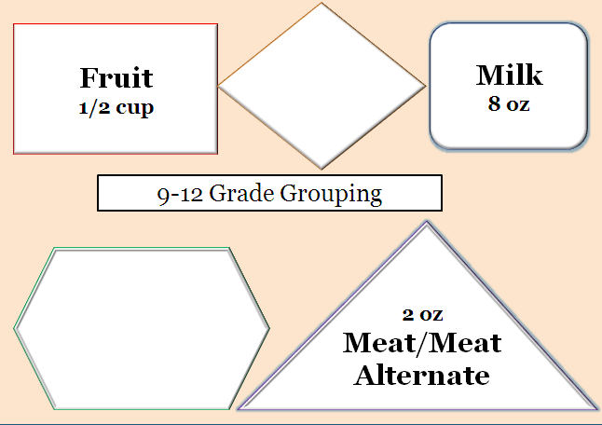
Yes
Student selected:
Two full components and a reduced fruit portion:
Milk
Meat/Meat Alternate
1/2 cup Fruit (allowable reduced portion)

Slide 10
Grain
2 oz
Fruit
1/2 cup
9-12 Grade Grouping
Vegetable
1/2 cup
Notes:
All

Slide 11
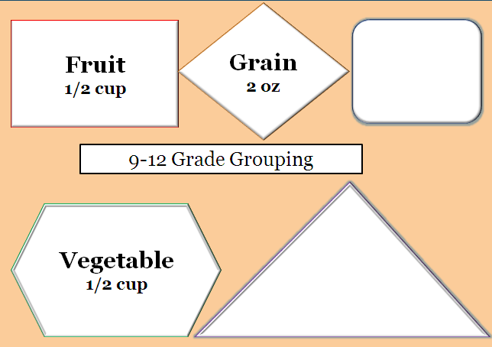
No
Student selected:
One full component and two reduced portions of fruit and vegetable:
Full Grain
1/2 cup Vegetable
1/2 cup Fruit
Either vegetable or fruit may be reduced to 1/2 cup but not both when only one additional full component is selected for high school student meals.

Slide 12
Grain
2 oz
Fruit
1/2 cup
9-12 Grade Grouping
Vegetable
1 cup
Notes:
All

Slide 13
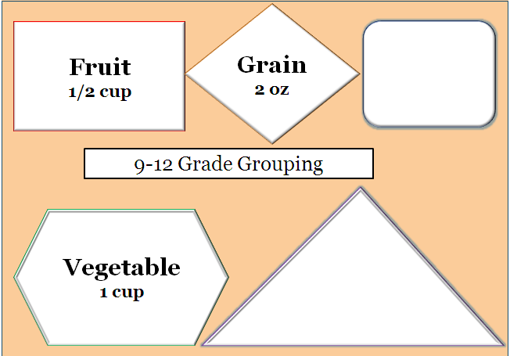
Yes
Student selected:
Two full components and allowable reduced fruit portion:
Grain
1 cup Vegetable
1/2 cup Fruit
Either the vegetable or fruit may be reduced to 1/2 cup and the other is a full component when the 1 cup portion is selected. Tip: Plan daily choices of Vegetables from fresh, canned, frozen varieties offered as hot and cold choices.

Slide 14
Milk
8 oz
Grain
2 oz
Fruit
1/2 cup
9-12 Grade Grouping
Vegetable
1/2 cup

Slide 15
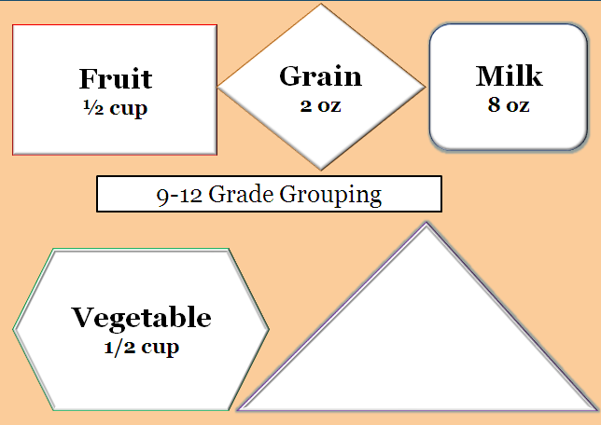
Yes
Student selected:
Two full components and two reduced portions:
Grain
Milk
1/2 cup Vegetable
1/2 cup Fruit
Both the fruit and vegetable may be reduced to 1/2 cup but only one of the two may count as a full component at the reduced portion. Fruit is a “bonus” item in this example.

Slide 16
Milk
8 oz
Grain
2 oz
9-12 Grade Grouping
2 oz
Meat/Meat Alternate

Slide 17
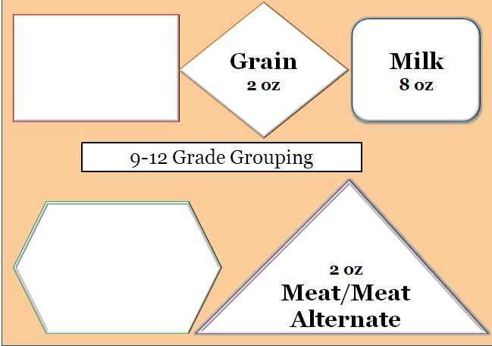
Students must select either a Vegetable or Fruit component portion for this meal to be reimbursable. Tip: Offer multiple choices of Fruit choices daily at each meal from fresh, frozen, canned, dried and 100% juices.
No
Student selected:
Three full components but no portions of fruit or vegetable selected:
Full Grain
Milk
Meat/Meat Alternate

Slide 18
Milk
8 oz
Grain
2 oz
9-12 Grade Grouping
2 oz
Meat/Meat Alternate
Vegetable
1/4 cup

Slide 19
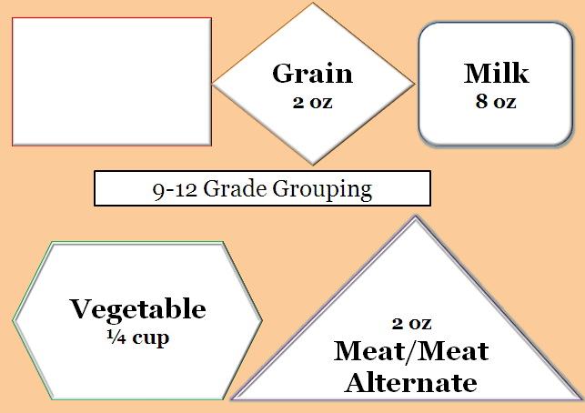
No
Student selected:
Three full components and “extra” portion of vegetable:
Grain
Milk
Meat/Meat Alternate
1/4 cup Vegetable
Students must select no less than 1/2 cup of either Vegetable or Fruit component (or combined 1/2 cup) as one of the three minimum components to have a complete reimbursable lunch meal.

Slide 20
Milk
8 oz
Grain
2 oz
9-12 Grade Grouping
2 oz
Meat/Meat Alternate
Vegetable
1/2 cup

Slide 21

Yes
Student selected:
Three full components and one reduced vegetable portion:
Grain
Milk
1/2 cup Vegetable
Meat/Meat Alternate

Slide 22
Milk
8 oz
Fruit
1/2 cup
9-12 Grade Grouping
2 oz
Meat/Meat Alternate
Vegetable
1/8 cup

Slide 23
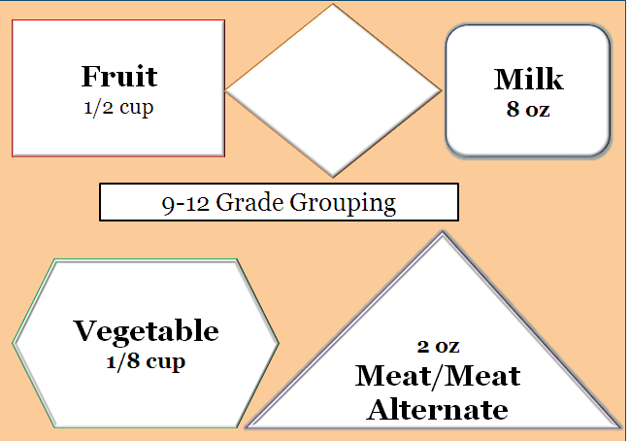
Yes
Student selected:
Two full components and 1/2 cup fruit with an extra vegetable:
Milk
Meat/Meat Alternate
1/2 cup Fruit
1/8 cup Vegetable
Student selected 1/2 cup fruit which meets the minimum requirement for a reimbursable meal and an additional reduced portion of vegetable component that counts as an extra food item.

Slide 24
OVS Summary
OVS – Summary/Comparison Chart
OVS is optional for grades K-8 in lunch and breakfast. | OVS is required for high school grades 9-12 at lunch and optional at breakfast.
Five full components must be offered: Meat/Meat Alternative minimum 1 oz. eq. Grain minimum 1 oz. equivalent Vegetable 3/4 cup Fruit 1/2 cup Fluid Milk 1 cup | Five full components must be offered: Meat/Meat Alternative minimum 2 oz. eq. Grain minimum 2 oz. equivalent Vegetable 1 cup Fruit 1 cup Fluid Milk 1 cup
A reimbursable meal must contain three of five components A fruit or vegetable component (or combination of the two) with at least 1/2 cup portion and Two other full components
Decline options: Students are allowed to decline any two of five food components but must select at least 1/2 cup of either a fruit or vegetable or smaller portions combined equaling 1/2 cup.
Minimum amount of fruit and vegetable: The minimum creditable serving size for a fruit or a vegetable is 1/8 cup. Dried fruit doubles in credit (1/4 cup is 1/2 cup of fruit). Fresh, raw salad greens are halved (1 cup of romaine is 1/2 cup of vegetable).

Slide 25

Questions?
Need OVS posters?

